Slide 1
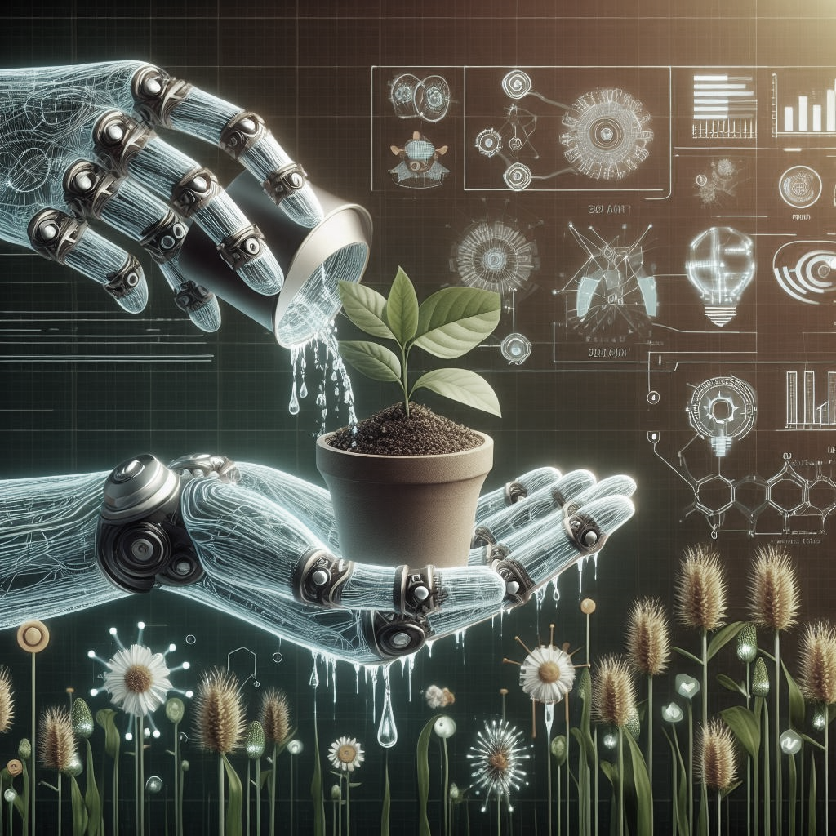
By: Navaneeth Krishna
PROJECT PRESENTATION
SMART SPROUT
PRESENTATION
A New Intelligent Irrigation

Slide 2
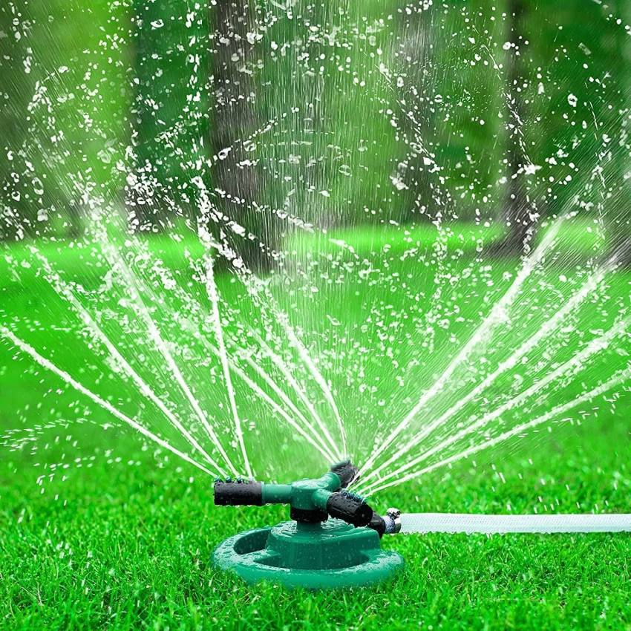

How do we water our plants in OUR campus?
Sprinklers
Water Pipes

Slide 3
But what is the problem?
High Water Loss: Traditional sprinklers and water pipes contribute to up to 50% water loss due to evaporation.
Inefficient Distribution: Uneven water distribution causes overwatering in some areas and underwatering in others.
Limited Control: Manual control fails to adjust watering based on changing environmental conditions, such as rainy or sunny days.

Slide 4
Solution
This is where Smart Sprout comes into play. By integrating Artificial Intelligence with a Drip Irrigation System, it optimizes the irrigation process, leading to enhanced plant maintenance. Smart Sprout can determine the water needs of plants based on multiple variables, a task that is not feasible for humans.

Slide 5
Key Features
Decision Making: Smart Sprout employs Artificial Intelligence algorithms to analyze diverse factors such as weather forecasts, soil moisture levels, soil acidity, and historical data. These factors collectively enhance the decision-making process, allowing for more precise and effective irrigation management.
Water Conservation: By optimizing watering schedules and minimizing water wastage through precise irrigation, Smart Sprout promotes sustainable water usage and conservation efforts.

Slide 6
Key Features
Alerts and Notifications: The system sends alerts and notifications to users' devices, informing them of any irregularities or issues detected in the irrigation process, such as water leaks or any abnormal change in the soil acidity or moisture levels so that we can take immediate action regarding the issue.
Scalability: Smart Sprout can be adjusted to different scales according to the user's needs, for example it can be used in small house garden or even handle a large agriculture field.

Slide 7
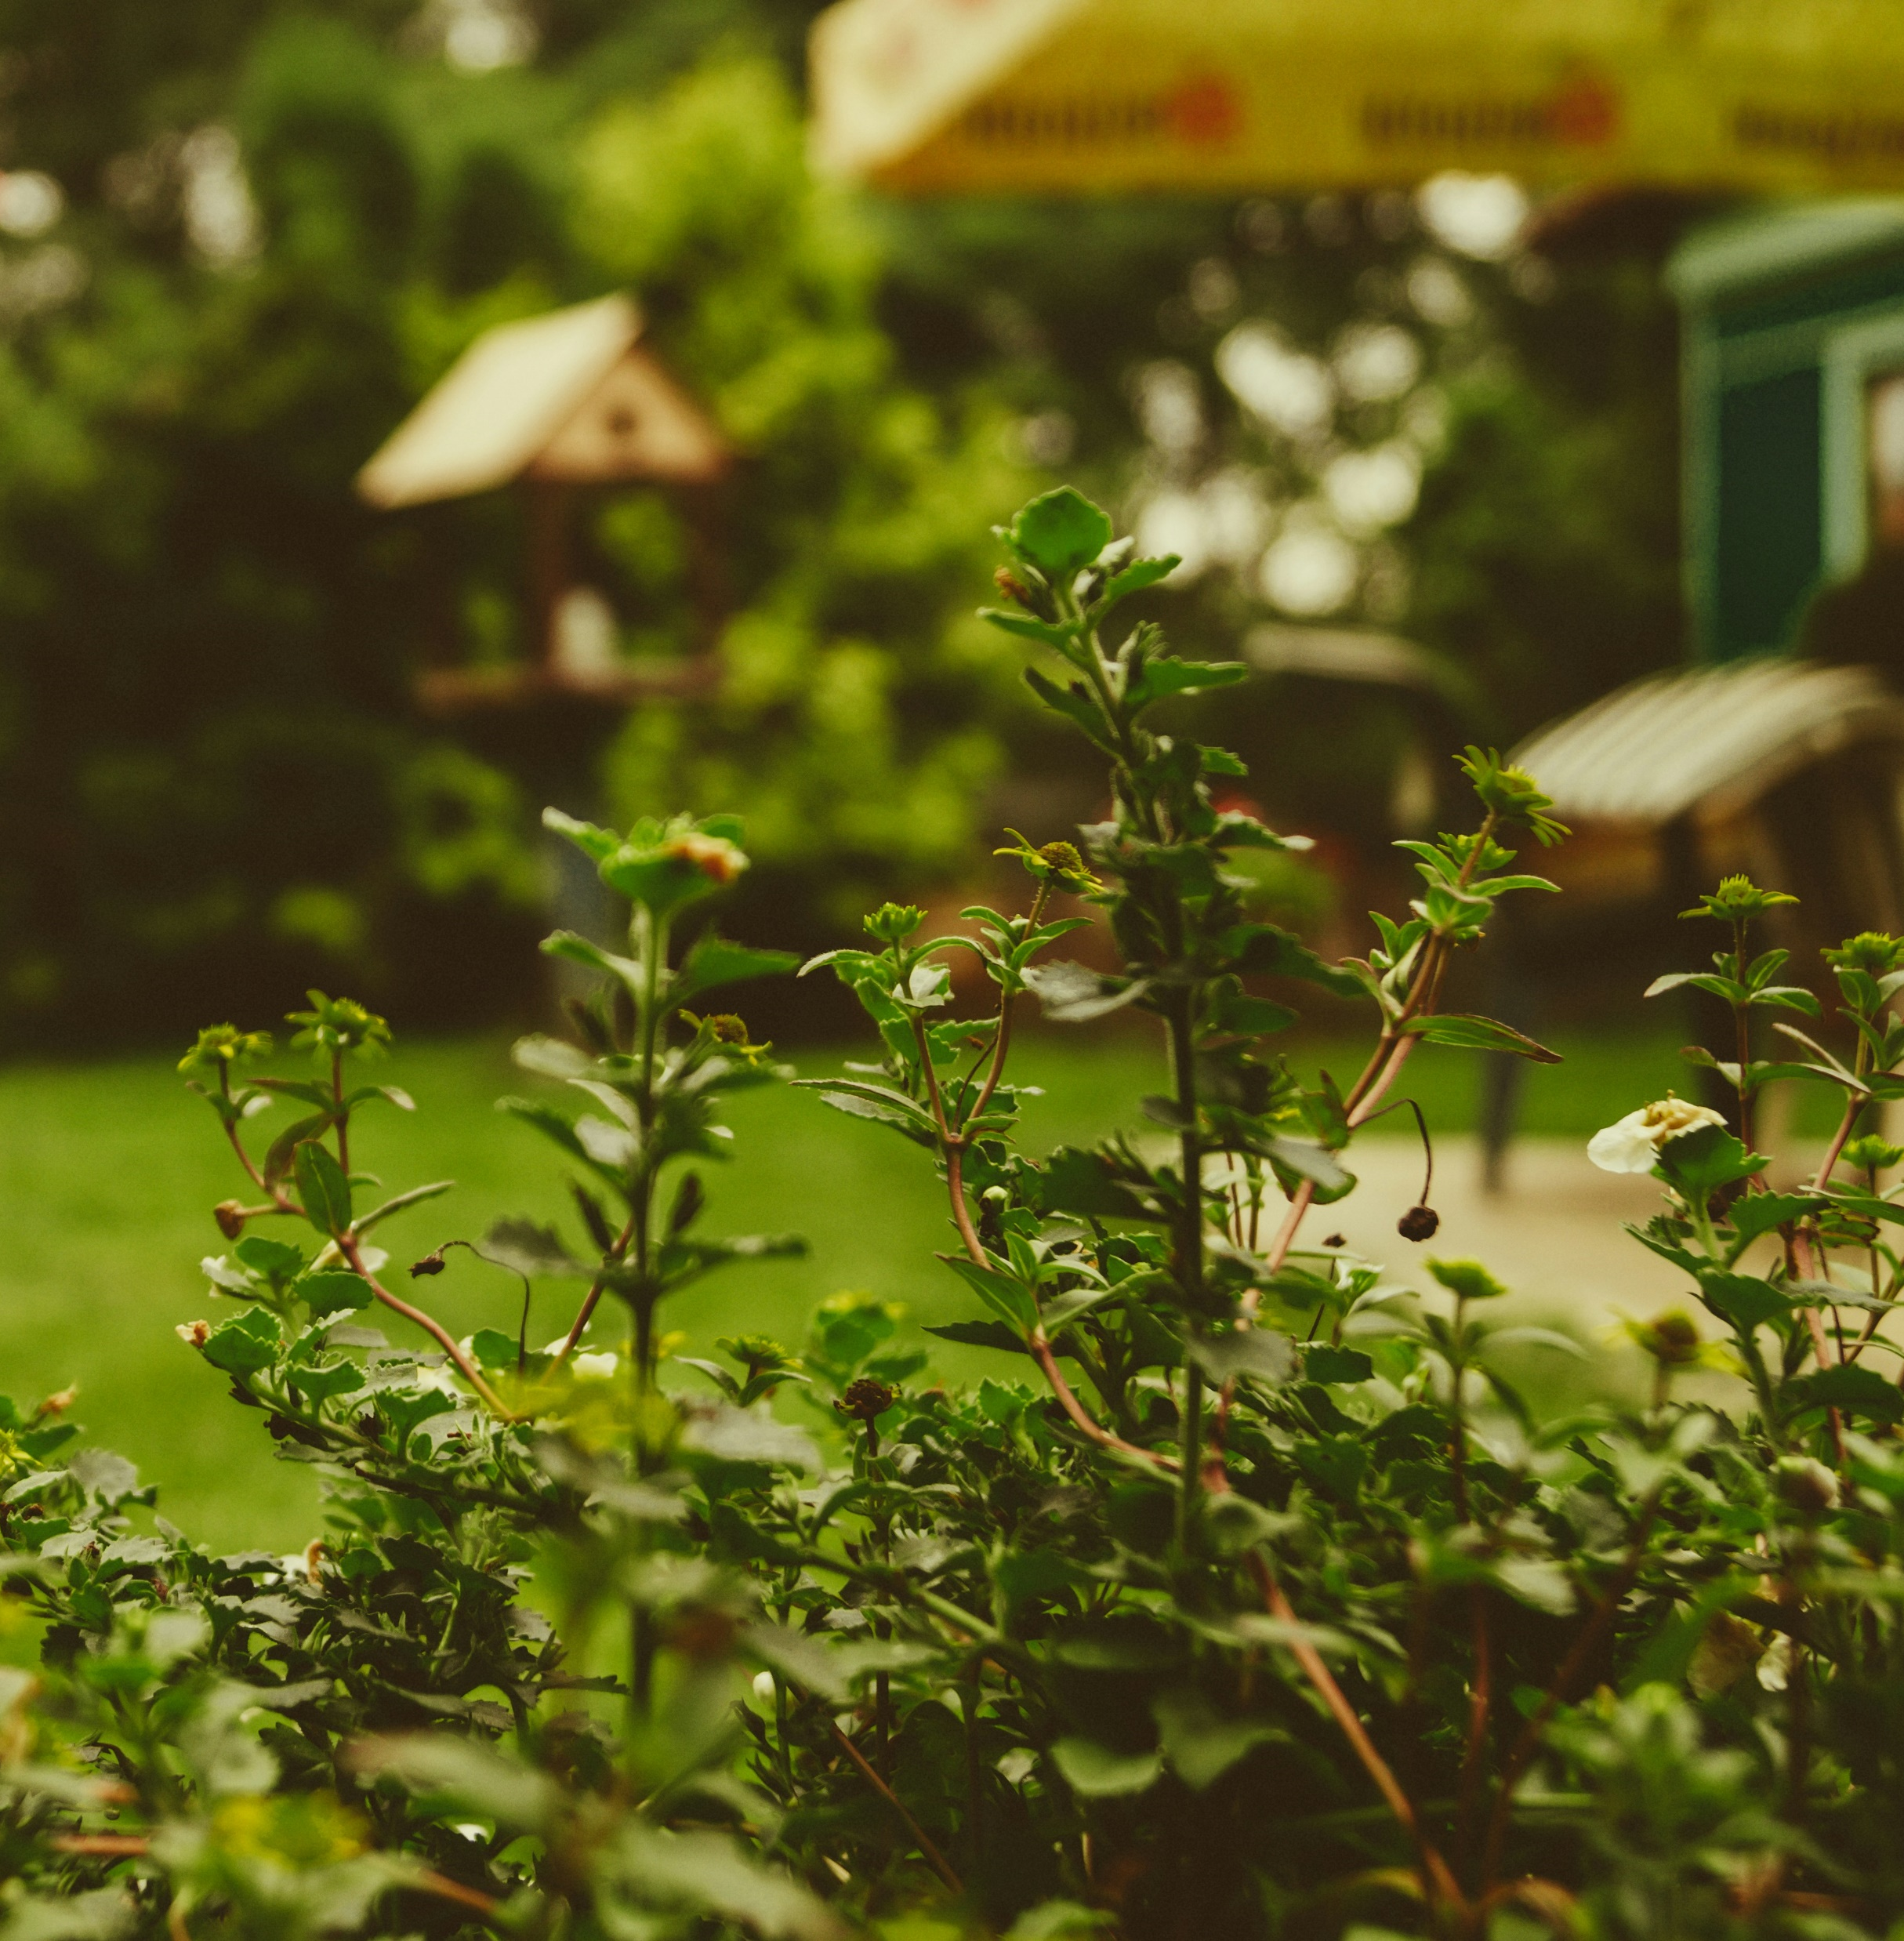
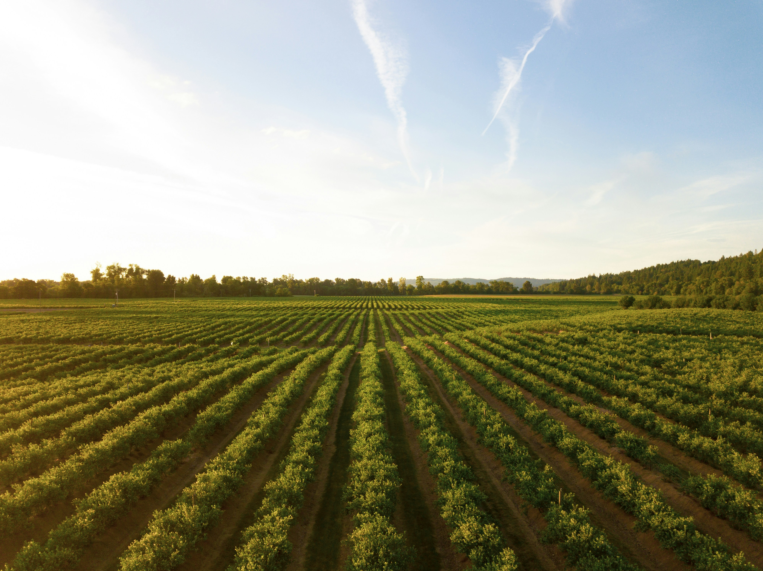
House Garden
Agriculture Field

Slide 8
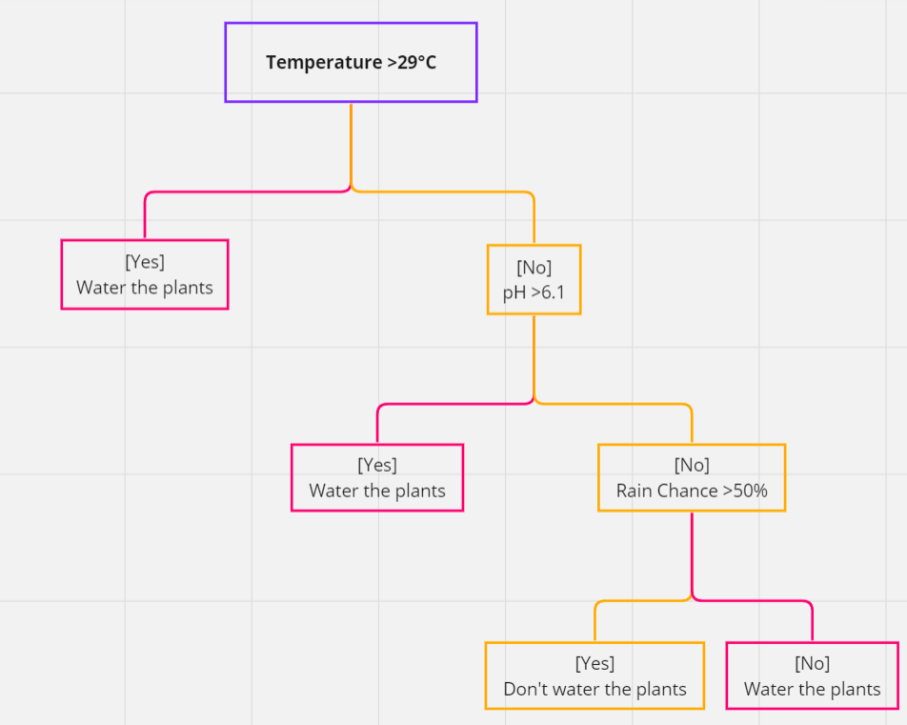
How It Works
As you can see, we have a demo decision tree that provides insight into how decisions are made at each level. Our model comprises various decision trees, each tailored to determine whether plants need watering based on the inputs provided.
NOTE: The provided decision tree is only for demo purpose

Slide 9

What if we have a missing DATA?

Slide 10
What If..?
Let us assume a scenario where we lack data regarding the likelihood of rainfall on a specific day.
Smart Sprout employs adaptive algorithms capable of handling missing or incomplete data without compromising the reliability of its output.
Incorporating user feedback mechanisms allows Smart Sprout to validate and adjust its predictions based on real-world observations, further enhancing the reliability of its output.

Slide 11
Conclusion
My Projects represents a solution for optimized irrigation system through the integration of Artificial Intelligence with advanced irrigation systems.
As a member of the Smart Tech Club, my goal is to transform our campus into a smart campus. Through my project, I aimed to integrate cutting-edge technologies like AI and IoT to optimize campus operations.

Slide 12



